Slide 1
SUSHMITHA S.H.
EMPLOYEE ID: 153014
JAVA FULL STACK, MIPL

Slide 2
CapStore Shopping Application

Slide 3
Project Requirements

Slide 4
Softwares:
Java 10
STS Version: 3.9.4.RELEASE
Eclipse Oxygen.3a (4.7.3a) platform
MySQL 5.5 Command Line Client
HTML 5
CSS 3
JavaScript
JSP
Spring Boot (2.0.4)
Spring Rest
Notes:
Fixar a posicao do titulo – sempre do lado esquerdo.
Sempre que tiver muito texto o coluna deve sempre ser “ narrowed” , se nao fica dificil de ler. Colocar paragrafos no texto.
Linha vertical deve ser mais fina e as pontas NUNCA devem ser arredondadas.

Slide 5
MODULE
SEARCH

Slide 6
Search functionality for customer
The customer is on the home page and wishes to search for a product, then it can be done in 2 ways.
Go to search bar and type the product name you wish to search
Else there will be an option ‘shop by category’. Select the category, then list of products of that category will appear.

Slide 7
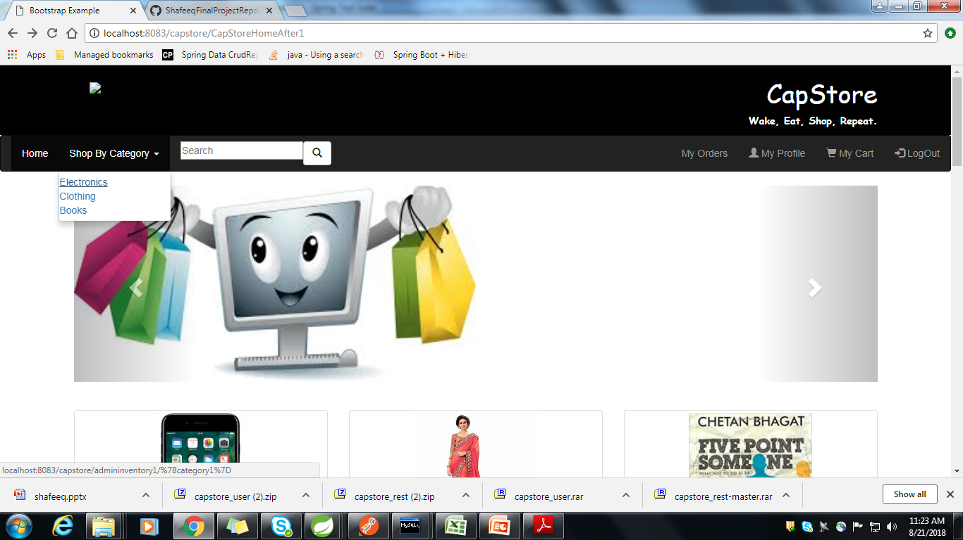
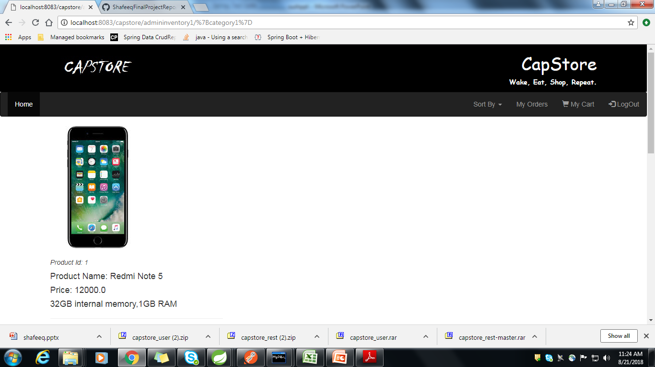

Slide 8
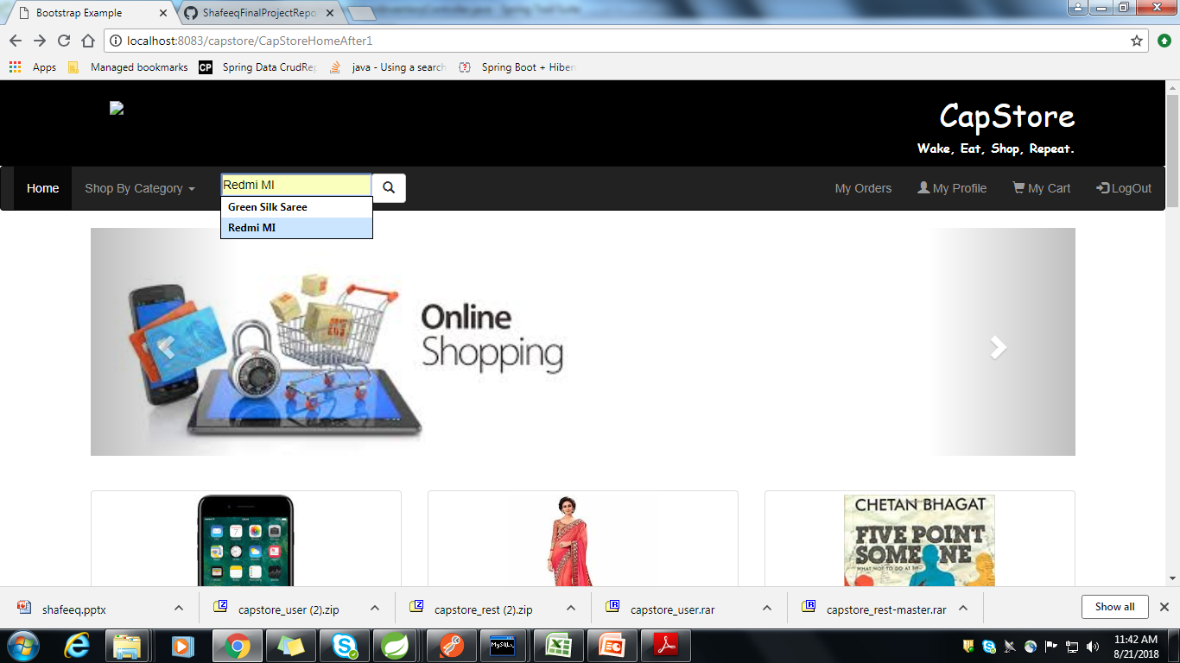
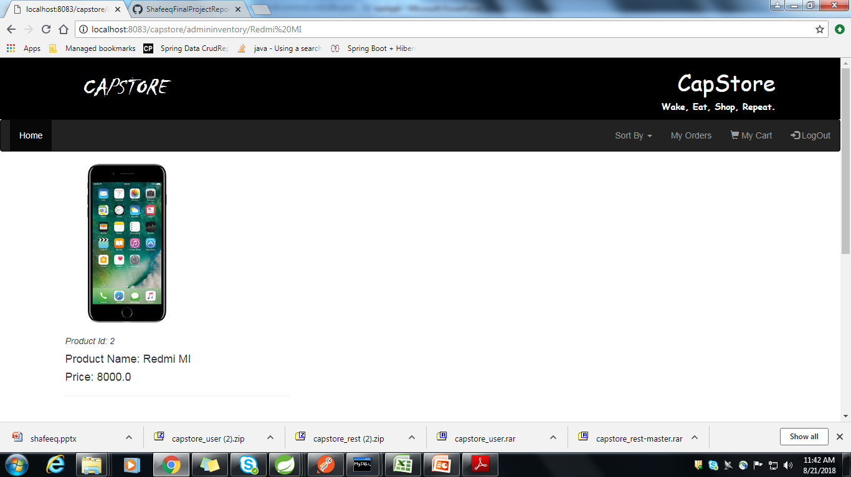

Slide 9
Search functionality for admin
When the admin logs in, he has the access to see list of customers, list of inventories or the list of merchants.
To search for a customer, type the customer name in the search bar. The corresponding details will be fetched.
To search for a merchant, type the merchant name in the search bar. The corresponding details will be fetched.
To search for a product in the inventory, type the product name in the search bar. The corresponding details will be fetched.

Slide 10
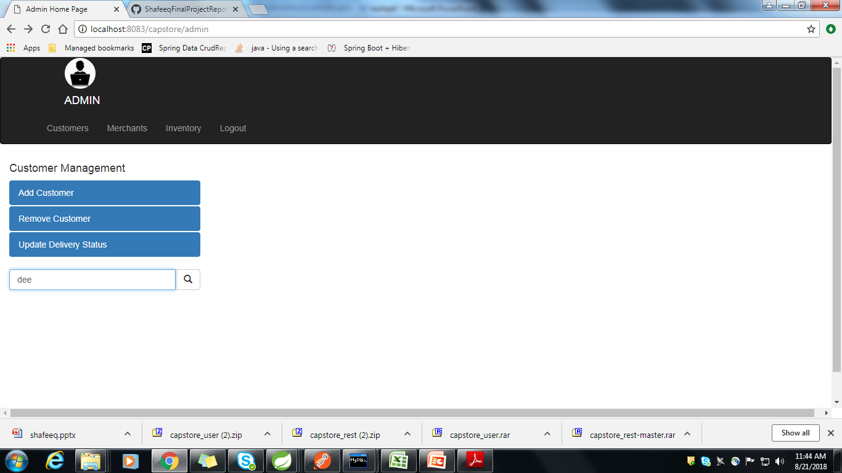
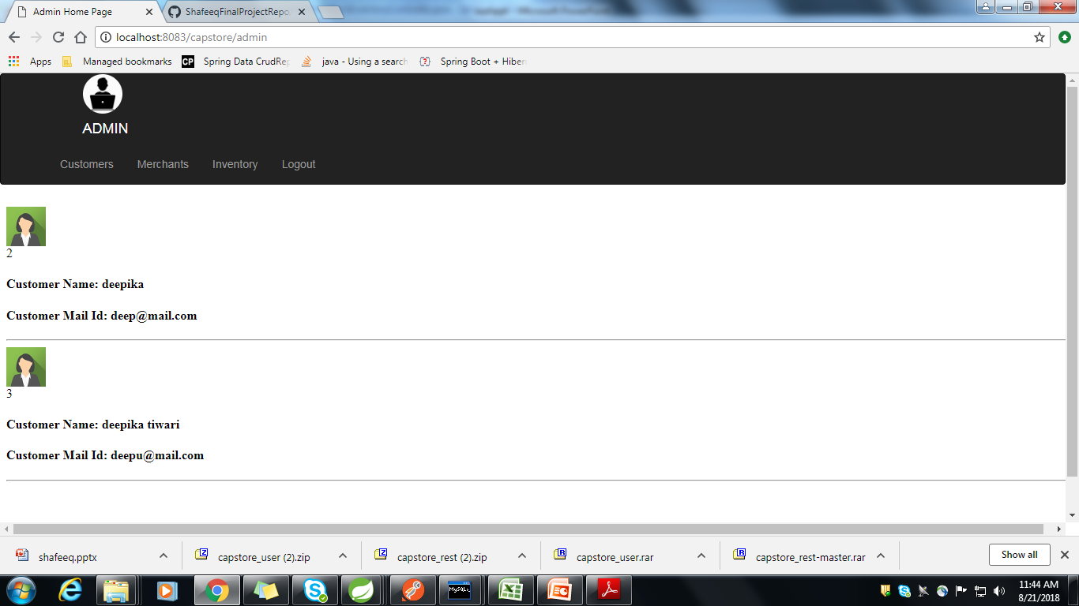

Slide 11

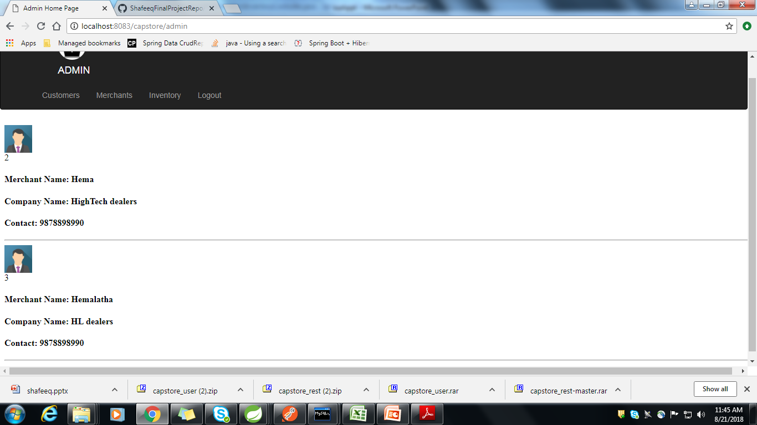

Slide 12
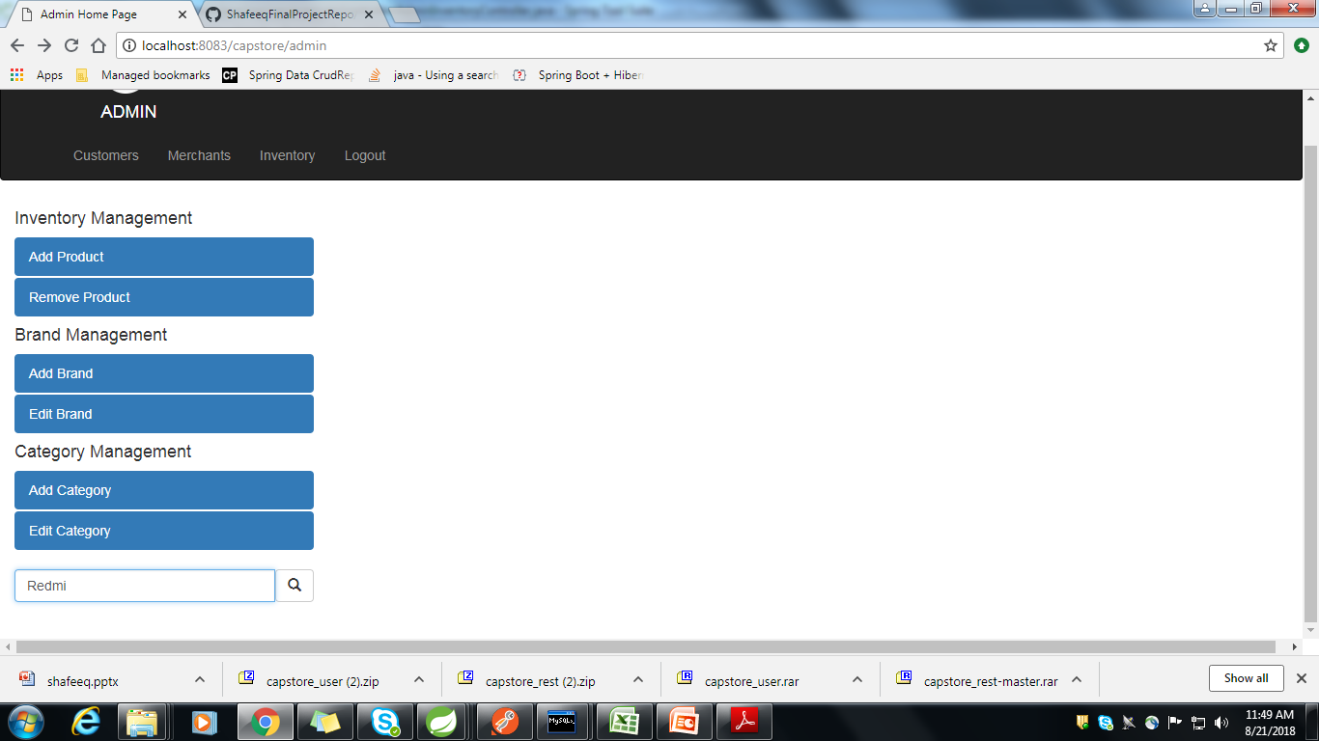
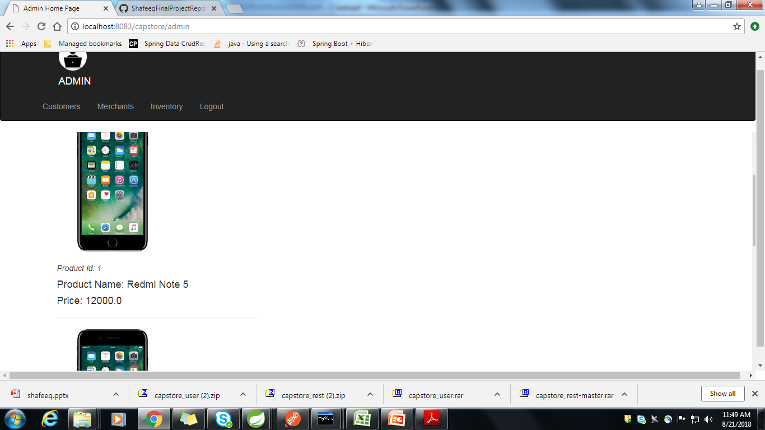

Slide 13
Search functionality for merchant
When the merchant logs in, he has the access to see list of products in his own inventory.
If he tries to search for a product not available in his inventory, then it wont be available.

Slide 14
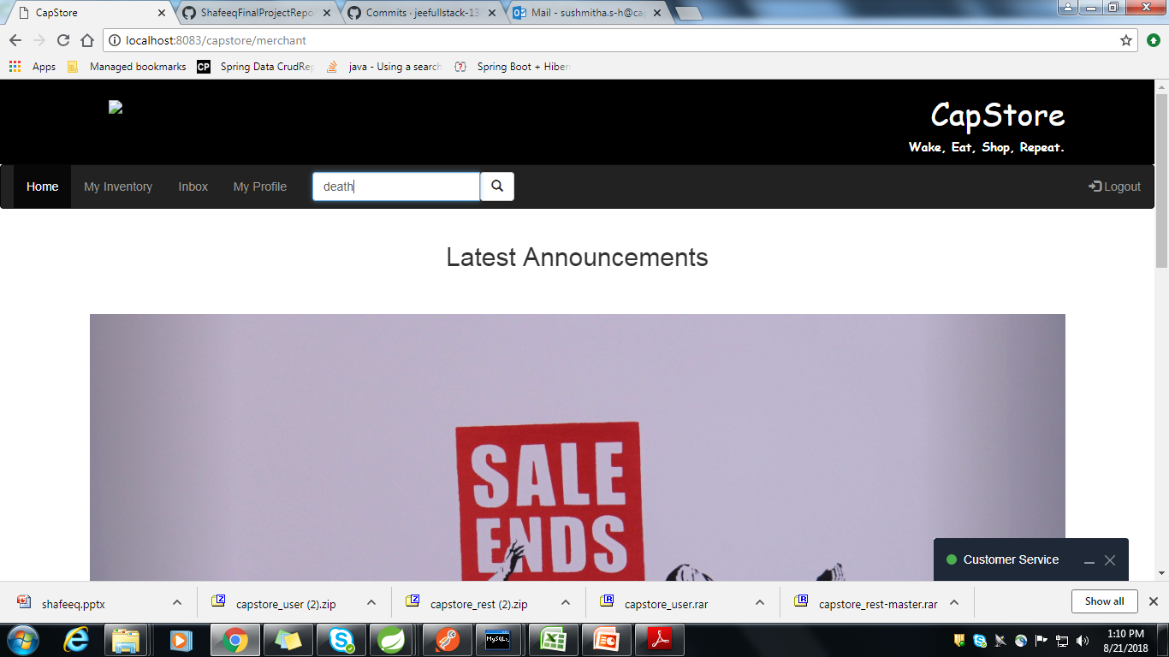
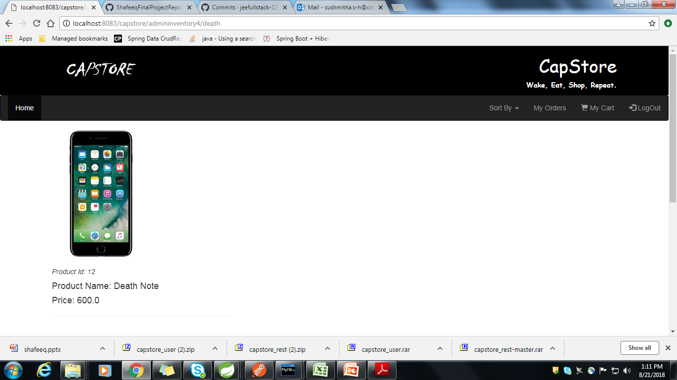

Slide 15
Thank You
Notes:
O Box atras do texto desnecessario. Deixar o layout mais simples.

